Slide 1




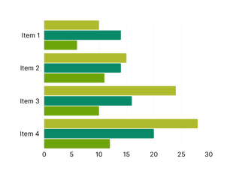
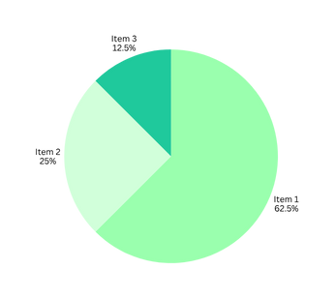
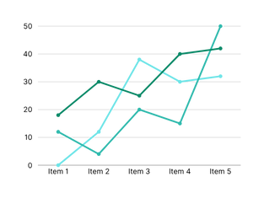



This could be the main title of your research
Mario Brosito1, Bowser Baddy2, Shoe Backa3
Affiliated Organization
INTRODUCTION
The results showed that exposure to natural light had a positive impact on students’ productivity. Statistical analysis revealed significant differences in both objective test scores and self-reported concentration levels between the two groups.
Natural light is known to influence human mood and productivity. However, limited studies have examined its effect among university students in Malaysia. This research aims to determine whether increased exposure to natural light improves students’ productivity during study sessions.
  Natural light influences mood, focus, and performance.
  Many studies show benefits of natural light globally.
  Limited research exists for Malaysian university students.
  Results can help improve study space designs in universities.
  This study investigates if natural light improves student productivity.
Figure 2 : Bar Chart
Natural light is known to influence human mood and productivity. However, limited studies have examined its effect among university students in Malaysia. This research aims to determine whether increased exposure to natural light improves students’ productivity during study sessions.
The results showed that exposure to natural light had a positive impact on students’ productivity. Statistical analysis revealed significant differences in both objective test scores and self-reported concentration levels between the two groups.
METHODOLOGY
This study involved an experimental design to examine the effects of natural light on student productivity. Fifty undergraduate students were recruited and divided into two groups to compare their performance under different lighting conditions. Productivity was assessed through both objective and subjective measures, and statistical analysis was conducted to determine significant differences between groups.
Figure 3: Pie Chart
DISCUSSION
Fifty undergraduate students participated in the study
The findings of this study demonstrate that natural light exposure can significantly enhance student productivity. Students who studied under natural light performed better on reading comprehension tests and reported higher concentration levels compared to those who studied under artificial lighting. These results align with previous studies suggesting that natural light increases alertness, reduces eye strain, and improves overall cognitive performance. However, other factors such as prior sleep quality, time of day, and personal lighting preferences might have also influenced the outcomes.
Participants were randomly divided into two groups:
  Group 1 studied in a room with natural light.
  Group 2 studied in a room with artificial light.
A reading comprehension test was used to measure academic productivity.
Natural light increases alertness
Participants also completed a self-reported concentration rating scale after the task.
Natural light reduce eye strain
Natural light improves overall cognitive performance
Data were analysed using independent t-tests to compare the results between the two groups.
Further research with larger sample sizes and varied academic tasks is needed to strengthen these findings and explore long-term effects.
RESULTS
CONCLUSION
In conclusion, natural light exposure has a positive impact on university students’ productivity during study sessions. This suggests that universities should consider designing study areas with greater access to natural lighting to enhance students’ focus and academic performance. Incorporating natural light into learning environments may be a simple yet effective strategy to support student well-being and educational success. Furthermore, creating naturally lit spaces can promote a healthier and more comfortable study environment. Such improvements may also increase student satisfaction with campus facilities. Encouraging students to study in well-lit areas could enhance their learning efficiency.
The results showed that exposure to natural light had a positive impact on students’ productivity. Statistical analysis revealed significant differences in both objective test scores and self-reported concentration levels between the two groups.
The results showed that exposure to natural light had a positive impact on students’ productivity. Statistical analysis revealed significant differences in both objective test scores and self-reported concentration levels between the two groups.
REFERENCE
  Boubekri, M., et al. (2014). Impact of windows and daylight exposure on overall health and sleep quality of office workers. Sleep Health, 1(1), 1-6.
  Li, D., & Sullivan, W.C. (2016). Impact of views to school landscapes on recovery from stress and mental fatigue. Landscape and Urban Planning, 148, 149-158.
  Alimoglu, M.K., & Donmez, L. (2005). Daylight exposure and the other predictors of burnout among nurses in a university hospital. International Journal of Nursing Studies, 42(5), 549-555.
  Smolders, K.C.H.J., & de Kort, Y.A.W. (2014). Bright light and mental fatigue: Effects on alertness, mood, and performance. Biological Psychology, 97, 116-123.
Figure 2 : Line Chart

